Slide 1
Community Engagement
October 2023

Slide 3
Achievement, Attendance and Graduation Data

Slide 4
58 Native American Graduates 2021-22

Slide 5
Jefferson County School District 509-J
(Madras High School & Bridges)
Native American Students Five Year Graduation Data
66 Native American Graduates 2021-22

Slide 6
32 Native American Students Dropped Out in 2021-22
Notes:
Remember no 10 day drop in 2020-21………

Slide 7
75 Students Met 2023

Slide 8
29 Students Met 2023

Slide 9
The percentage of students in their first year of high school who have earned at least 25% of the number of credits required for a high school diploma. This is a minimum of 6 credits.
47-- 9th Grade Students On Track 2023

Slide 10
397 Students Present 90% of Days 2023

Slide 11
Participation Data

Slide 12
Activity Bus Ridership

Slide 13
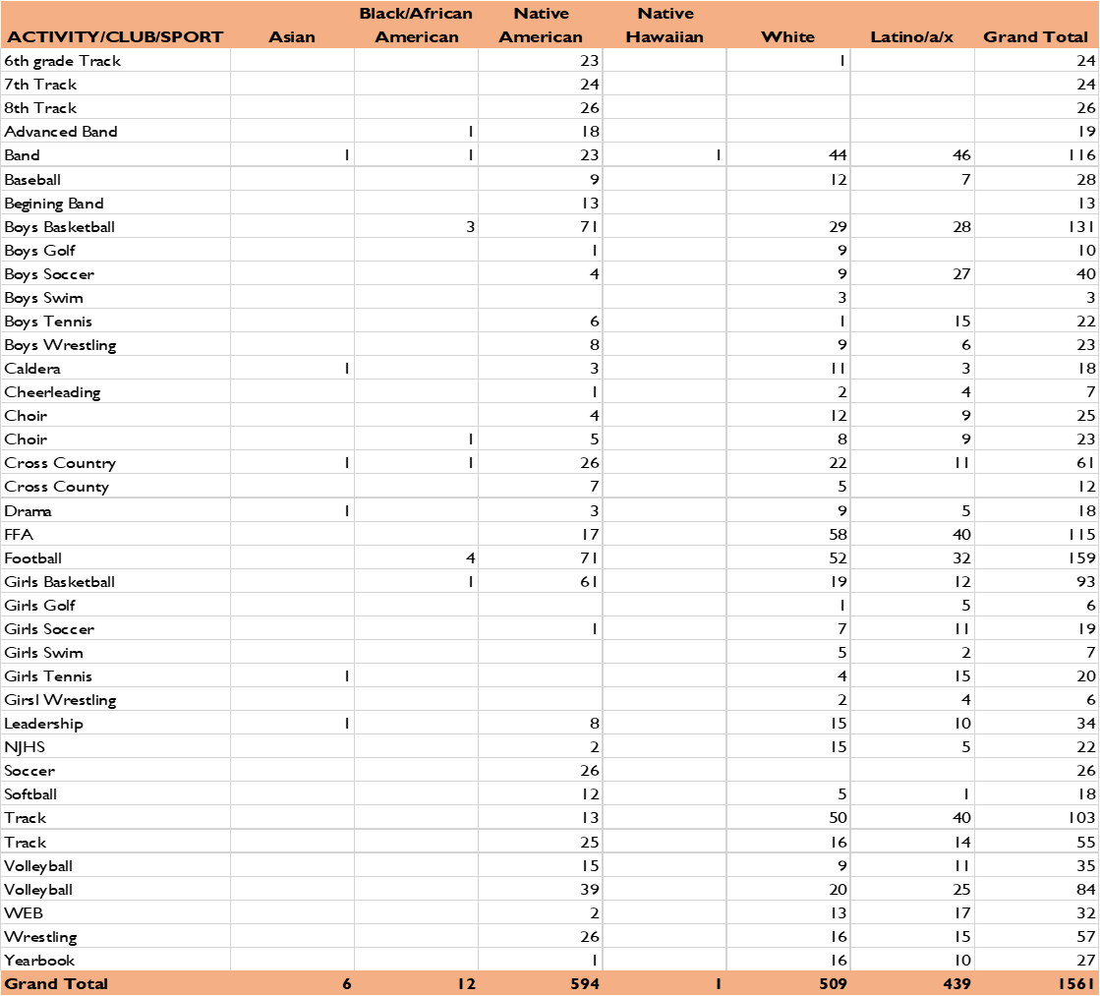
Student Participation

Slide 14
Participation by School

Slide 15
Expenditure Data

Slide 16
