Slide 1

Welcome Families! Title 1A School Wide Program
Annual Meeting
Metolius Elementary
Notes:
Add School Name and Logo

Slide 2
Purpose of Today’s Meeting
Provide information about our school’s Title I-A program for parents of students participating in the program

Slide 3
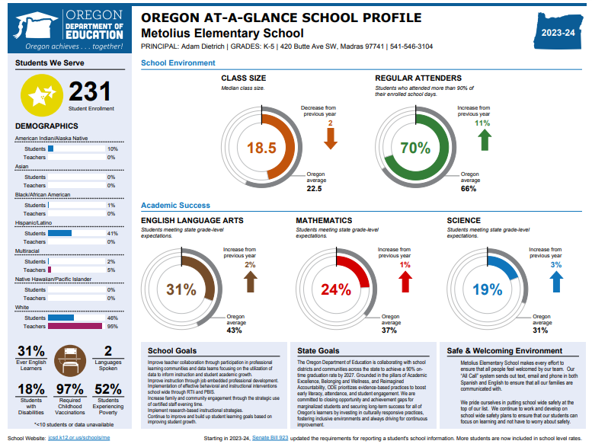
Update on School’s Progress
Notes:
Add student achievement results for your school. (State report card – due to be released Oct. 10th)
If Priority, Focus or Model school, share current status and what does that mean to parents?

Slide 4
Title I-A Program
What is “Title I-A”?
Title I-A is United States Government’s largest education assistance program for schools.
Funds are used to provide programs to help children who are struggling in reading and math.
Extra help (in addition to what they learn during math and reading time in the classroom)
Funding provided under ESEA

Slide 5
Title I-A Program Components
Design of Program
Assessments & Monitoring
Annual Review
Parent Involvement

Slide 6
Design of our Program
Schoolwide Program
Schoolwide – all students
Curriculum Utilized: K-5
Benchmark Advanced
HMH Into Math
Curriculum Utilized 6-8:
Amplify
Ed Gems

Slide 7
Assessments & Monitoring
Assessments our school uses:
SMARTER Balanced, Dibels Reading/Math, MAP Growth, and in-program check points
Notification of your child’s assessment results
SMARTER Balanced: reports sent home
Dibels Reading/Math & in-program check points: distributed at conferences
Progress monitoring process

Slide 8
Parent’s Rights under ESEA
Right to request teacher qualifications
Participate in decisions affecting your child
Participate in school activities
Request opportunities to meet regularly with staff for parent involvement
Review school’s Title I-A plan and make suggestions

Slide 9
Important Dates / Upcoming Events
Literacy Nights
Math Nights
Parent/Teacher Conferences
Advisory Council Meetings
Other
Notes:
Customize for your schools family engagement and parent meetings.

Slide 10
Annual Review & Evaluation
Review plan
Request feedback
Provide Any clarification
Discuss plans for upcoming year

Slide 11
Questions and Input?
See Erika Westlind or email ewestlind@509j.net
Thank You for Stopping By!
Notes:
Add Reading Specialist name to “see___” and reading specialist room number and email.

