Slide 1

Welcome Families! Title 1A School Wide Program
Annual Meeting
Warm Springs K-8 Academy

Slide 2
Purpose
Provide information about our school’s Title I-A program for parents of students participating in the program

Slide 3
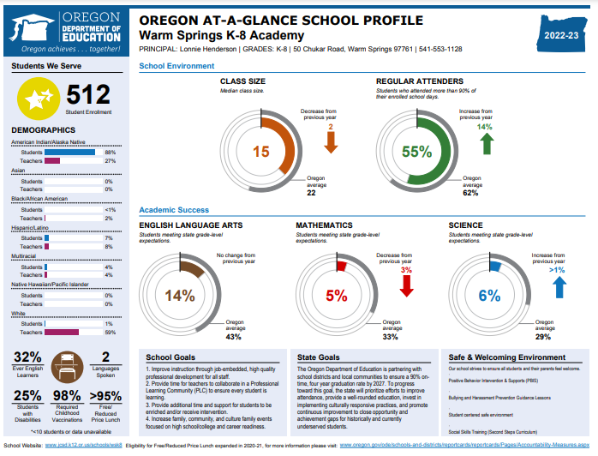
Update on School’s Progress
23/24
Not available yet.
Notes:
Add student achievement results for your school.
If Priority, Focus or Model school, share current status and what does that mean to parents?

Slide 4
What is “Title I-A”?
What is “Title I-A”?
Title I-A is United States Government’s largest education assistance program for schools.
Funds are used to provide programs to help children who are struggling in reading and math.
Extra help (in addition to what they learn during math and reading time in the classroom)
Funding provided under ESEA (Elementary and Secondary Education Act)

Slide 5
Title I-A Program Components
Design of Program
Assessments & Monitoring
Annual Review
Parent Involvement
Notes:
Design of Program – What does the program look like? What interventions are in place? What curriculum are we using? What’s the goal?
Assessments & Monitoring – How are we assessing our students? How are we monitoring our students to see if there’s any progress?
Parent Involvement – One of the key components is the involvement of our families. Not only in ensuring that we are addressing all the rights of our families, but providing opportunities for our families to learn more about our curriculum and possible strategies that they can use at home to help their students.
Annual Review – Annually review and evaluating the plan to see if its working . Determining what’s working, what needs to changes and adjusting the plan based on feedback from district personnel and our community.

Slide 6
Design of our Program
Schoolwide Program
Schoolwide – all students
Curriculum Utilized: K-5
Benchmark Advanced
Into Math: Houghton Mifflin Harcourt (HMH)
Curriculum Utilized 6-8:
Amplify
Ed Gems

Slide 7
Assessments & Monitoring
Assessments our school uses:
SMARTER Balanced, Dibels Reading, MAP Growth, and in-program check points
Notification of your child’s assessment results
SMARTER Balanced: reports sent home
Dibels Reading & in-program check points: distributed at conferences
Progress monitoring process

Slide 8
Parent’s Rights under ESEA
Right to request teacher qualifications
Participate in decisions affecting your child
Participate in school activities
Request opportunities to meet regularly with staff for parent involvement
Review school’s Title I-A plan and make suggestions
Notes:
Within the district policy and school plan, parents have the following rights:

Slide 9
Important Dates / Upcoming Events
Literacy Nights
Math Nights
Parent/Teacher Conferences
Notes:
Customize for your schools family engagement and parent meetings.

Slide 10
Annual Review & Evaluation
Review plan
Provide Any clarification
Request feedback
Discuss plans for upcoming year

Slide 11
Questions and Input?
See Elizabeth Villano (Miss Bee)
Room C-12
Thank You for Coming!

